Slide 1

Logistic Regression
Dr. Clif Baldwin

Slide 2
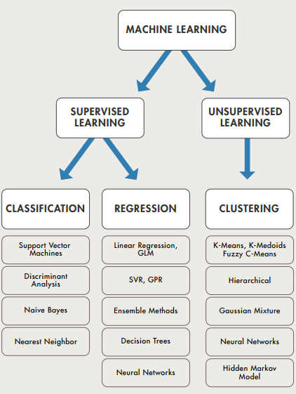
Notes:
https://www.datasciencecentral.com/profiles/blogs/machine-learning-summarized-in-one-picture
Regression = problems with a quantitative response (i.e. real values)
Classification = problems with a qualitative response (i.e. categories, discrete classes)
Data sets that can be separated exactly are said to be linearly separable.
The separating boundaries are called decision boundaries or decision surfaces.
SVR = Support Vector Regression
GPR = Gaussian Process Regression

Slide 3

Types of Machine Learning Algorithms in One Picture
Notes:
https://www.datasciencecentral.com/profiles/blogs/types-of-machine-learning-algorithms-in-one-picture

Slide 4
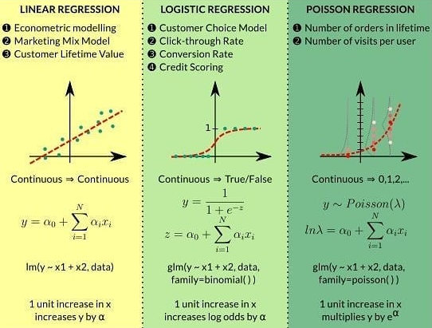
Different Types of Regression
Notes:
https://www.datasciencecentral.com/profiles/blogs/3-types-of-regression-in-one-picture-baba-png

Slide 5
Classification
Qualitative (or Categorical) responses
Yes/No; colors; grades; categories
Discriminant function – a function that assigns each vector x to a specific class (e.g. qualitative data)

Slide 6
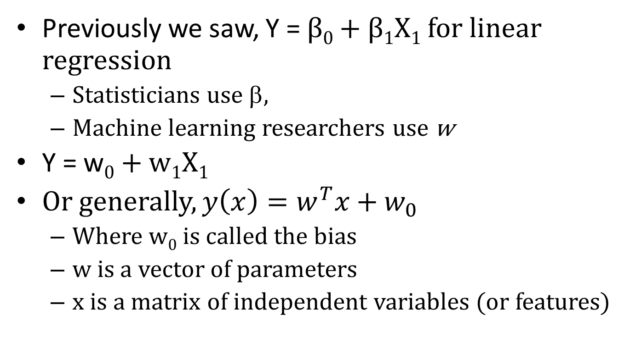
Classification
Previously we saw, Y = β₀ + β₁X₁ for linear regression
Statisticians use β,
Machine learning researchers use w
Y = w₀ + w₁X₁
Or generally, $y\left(x\right)=w^{T}x+w_{0}$
Where w₀ is called the bias
w is a vector of parameters
x is a matrix of independent variables (or features)

Slide 7
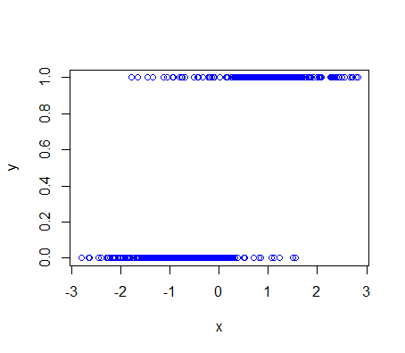
Linear Regression

Slide 8
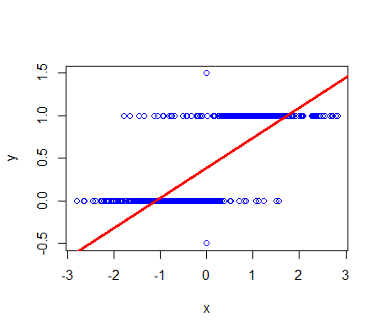
Linear Regression
Violation!
Violation!

Slide 9
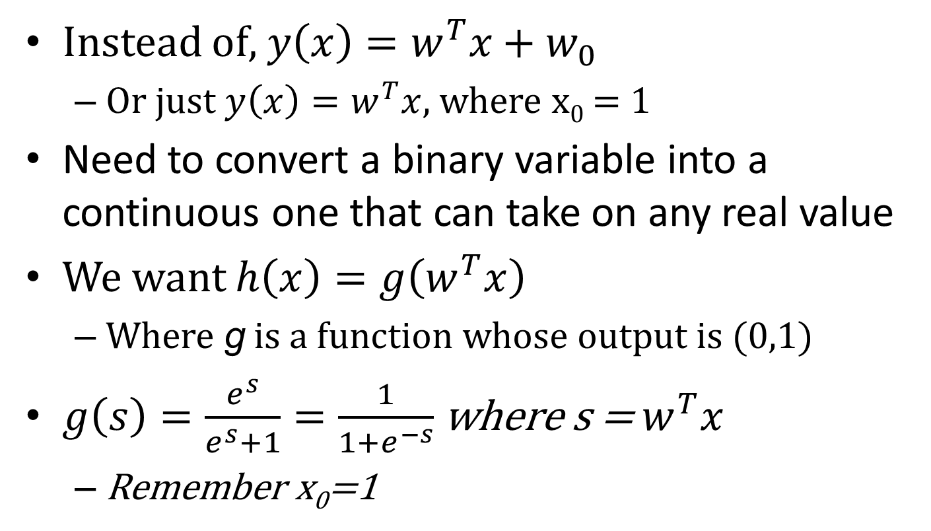
Logistic Regression
Instead of, $y\left(x\right)=w^{T}x+w_{0}$
Or just $y\left(x\right)=w^{T}x$, where x₀ = 1
Need to convert a binary variable into a continuous one that can take on any real value
We want $h\left(x\right)=g\left(w^{T}x\right)$
Where g is a function whose output is (0,1)
$g\left(s\right)=\frac{e^{s}}{e^{s}+1}=\frac{1}{1+e^{−s}}$ where s = $w^{T}x$
Remember x₀=1

Slide 10
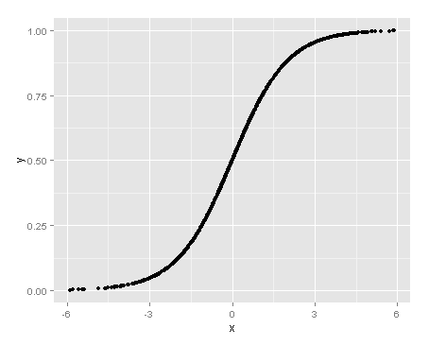
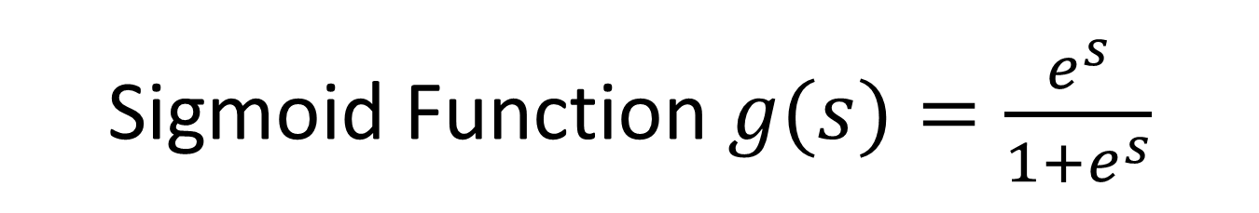
Sigmoid Function $g(s)=\frac{e^{s}}{1+e^{s}}$

Slide 11
Binary
If we code a binary decision as 0 or 1, then the mean of the distribution is equal to the proportion of 1’s
The mean of the distribution is also the probability of selecting a “1” at random from this distribution
Therefore, proportion and probability of “1” are the same in these cases

Slide 12
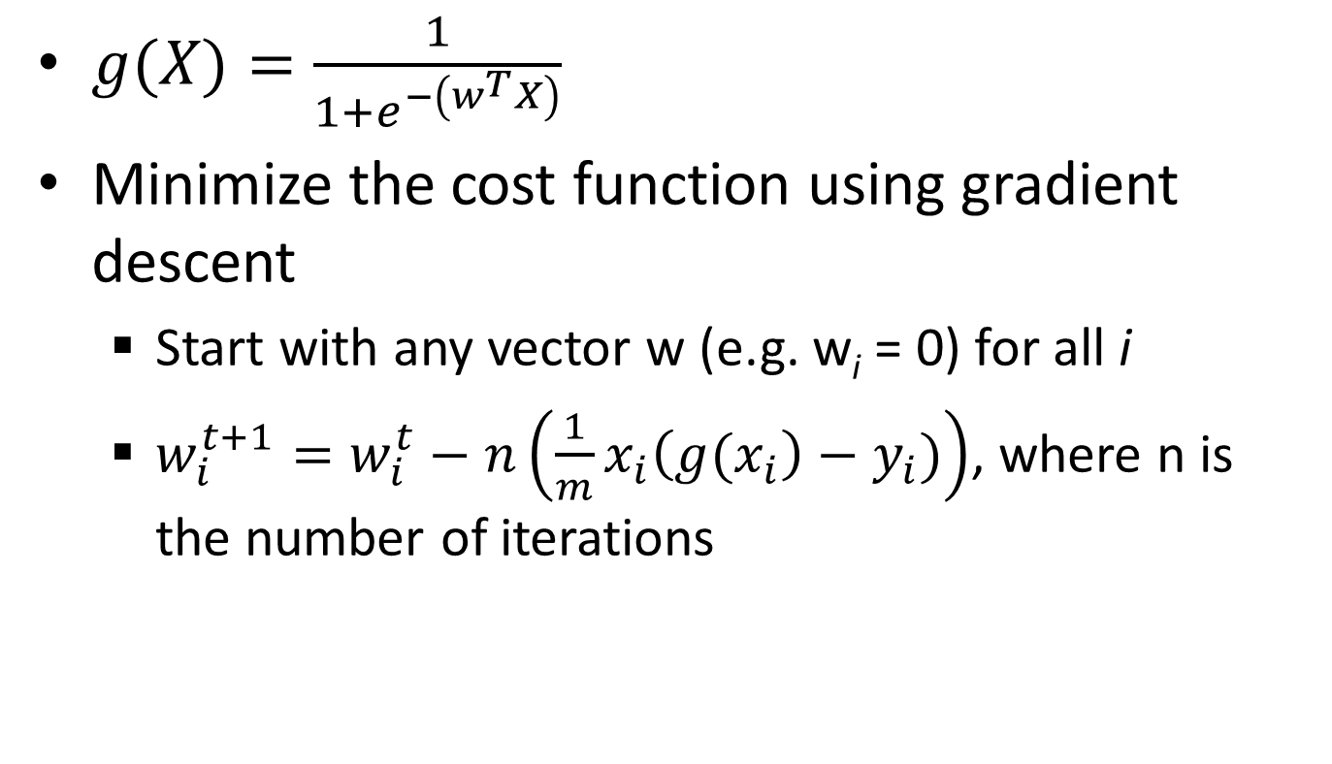
Logistic Function
$g(X)=\frac{1}{1+e^{−\left(w^{T}X\right)}}$
Minimize the cost function using gradient descent
Start with any vector w (e.g. w_{i} = 0) for all i
$w_{i}^{t+1}=w_{i}^{t}−n\left(\frac{1}{m}x_{i}\left(g(x_{i}\right)−y_{i})\right)$, where n is the number of iterations
Notes:
See section 14.1 of Shai Shalev-Shwartz and Shai Ben-David, 2014, Understanding Machine Learning: From Theory to Algorithms for a more in depth mathematical description.

Slide 13
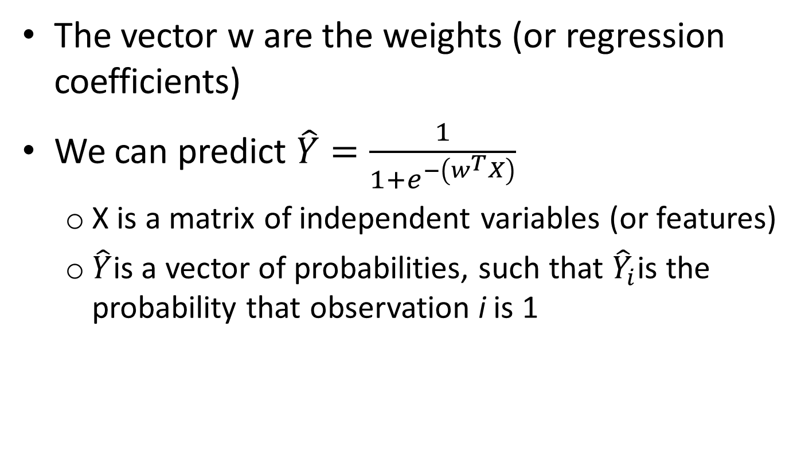
Logistic Function
The vector w are the weights (or regression coefficients)
We can predict $\hat{Y}=\frac{1}{1+e^{−\left(w^{T}X\right)}}$
X is a matrix of independent variables (or features)
$\hat{Y}$is a vector of probabilities, such that ${\hat{Y}}_{i}$is the probability that observation i is 1
Notes:
See section 14.1 of Shai Shalev-Shwartz and Shai Ben-David, 2014, Understanding Machine Learning: From Theory to Algorithms for a more in depth mathematical description.

Slide 14
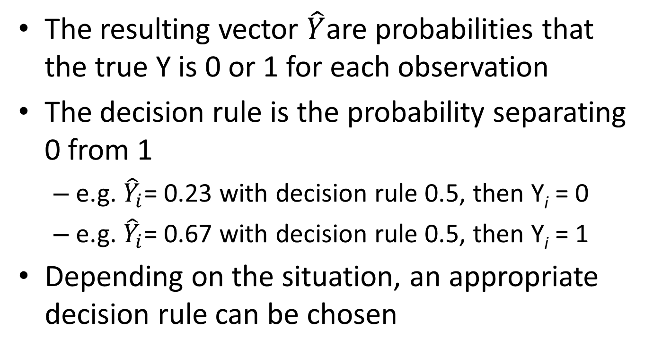
Decision Rule
The resulting vector $\hat{Y}$are probabilities that the true Y is 0 or 1 for each observation
The decision rule is the probability separating 0 from 1
e.g. ${\hat{Y}}_{i}$= 0.23 with decision rule 0.5, then Y_{i} = 0
e.g. ${\hat{Y}}_{i}$= 0.67 with decision rule 0.5, then Y_{i} = 1
Depending on the situation, an appropriate decision rule can be chosen

Slide 15
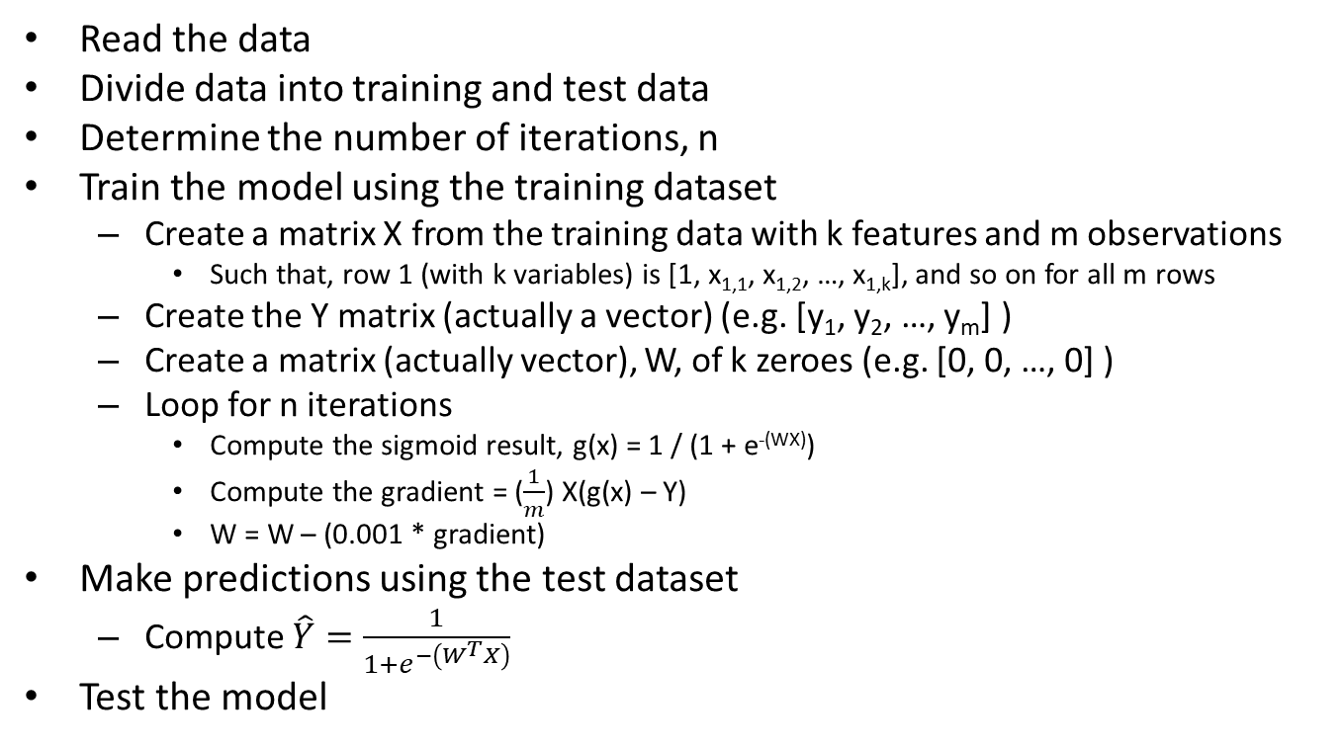
Pseudocode (gradient descent)
Read the data
Divide data into training and test data
Determine the number of iterations, n
Train the model using the training dataset
Create a matrix X from the training data with k features and m observations
Such that, row 1 (with k variables) is [1, x_{1,1}, x_{1,2}, …, x_{1,k}], and so on for all m rows
Create the Y matrix (actually a vector) (e.g. [y₁, y₂, …, y_{m}] )
Create a matrix (actually vector), W, of k zeroes (e.g. [0, 0, …, 0] )
Loop for n iterations
Compute the sigmoid result, g(x) = 1 / (1 + e^{-(WX)})
Compute the gradient = ($\frac{1}{m}$) X(g(x) – Y)
W = W – (0.001 * gradient)
Make predictions using the test dataset
Compute $\hat{Y}=\frac{1}{1+e^{−\left(W^{T}X\right)}}$
Test the model

Slide 16
Readings
Read pp. 184-202 of Bruce and Bruce, Practical Statistics
Read Chapter 4.1 - 4.3 of James, Witten, Hastie, and Tibshirani, 2013, An Introduction to Statistical Learning
Read “Making data science accessible – Logistic Regression” http://www.analyticbridge.datasciencecentral.com/profiles/blogs/making-data-science-accessible-logistic-regression
Read “Keep it simple! How to understand Gradient Descent algorithm” https://www.kdnuggets.com/2017/04/simple-understand-gradient-descent-algorithm.html
Read “Understanding Logistic Regression step by step” https://towardsdatascience.com/understanding-logistic-regression-step-by-step-704a78be7e0a

Slide 17
Assignment 3
Write a logistic regression algorithm in R using the logit (or sigmoid) function from scratch, which prints coefficients and accuracy metrics. Use the provided data. Document each step of the code to demonstrate you understand what each line of code does. The code has to describe the steps of the logistic regression model. For your algorithm, you may use basic statistical functions and graphing functions but NOT machine learning functions (i.e. no glm(), no predict(), no optim(), and related functions). Note, you must fully explain what solve() is doing if you use it (not the mathematics necessarily but an explanation for a general audience more than “The function solves the equation a %*% x = b for x, where b is a matrix”). Test your model with test data. Then compare your algorithm to the algorithms in R using glm() and predict().

Slide 18
Questions

Slide 19
R Code for Training/Test data
install.packages("caTools")
library(caTools)
split = sample.split(myData$Y, SplitRatio = 0.75)
Where myData$Y is the dependent (or response) variable
train = subset(myData, split == TRUE)
test = subset(myData, split == FALSE)
Notes:
indexes = sample(1:nrow(data1), size=0.75*nrow(data1))
train = data1[indexes,] # The training data has 75% of the observations
test = data1[-indexes,]

Slide 20
R – glm()
Use glm() {instead of lm()}
?glm for a description
Specify family=binomial to get logistic regression
model1=glm(y~., data=df, family=binomial)
Where df is some data.frame
glm.pred =predict(model1, newdata=data1, type="response")
To make predictions with the model1

Slide 21
R – glm()
library(tidyverse)
library(caTools)
myData <- read_csv(“group1.csv”)
split = sample.split(myData$Y, SplitRatio = 0.70)
train = subset(myData, split == TRUE)
test = subset(myData, split == FALSE)
model1=glm(y~X1+X2+X3, data=train, family=binomial)
prediction1 =predict(model1, newdata=test, type="response")

Slide 22
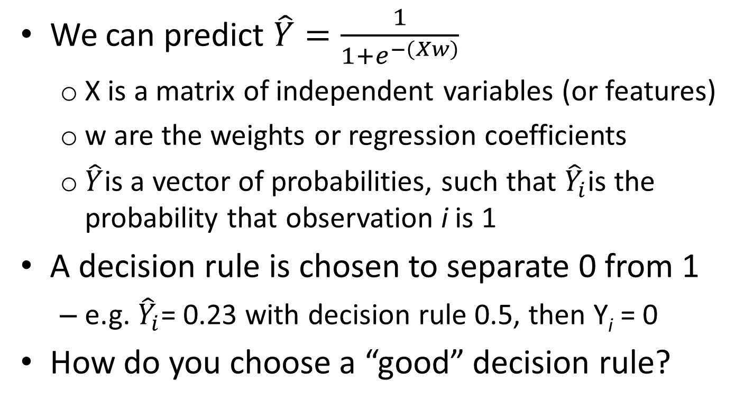
Logistic Function
We can predict $\hat{Y}=\frac{1}{1+e^{−\left(Xw\right)}}$
X is a matrix of independent variables (or features)
w are the weights or regression coefficients
$\hat{Y}$is a vector of probabilities, such that ${\hat{Y}}_{i}$is the probability that observation i is 1
A decision rule is chosen to separate 0 from 1
e.g. ${\hat{Y}}_{i}$= 0.23 with decision rule 0.5, then Y_{i} = 0
How do you choose a “good” decision rule?

Slide 23
Performance
Sensitivity – measures the proportion of positives that are correctly identified (true positive rate)
Specificity – measures the proportion of negatives that are correctly identified (true negative rate)
Accuracy – measures the proportion of correct identifications

Slide 24
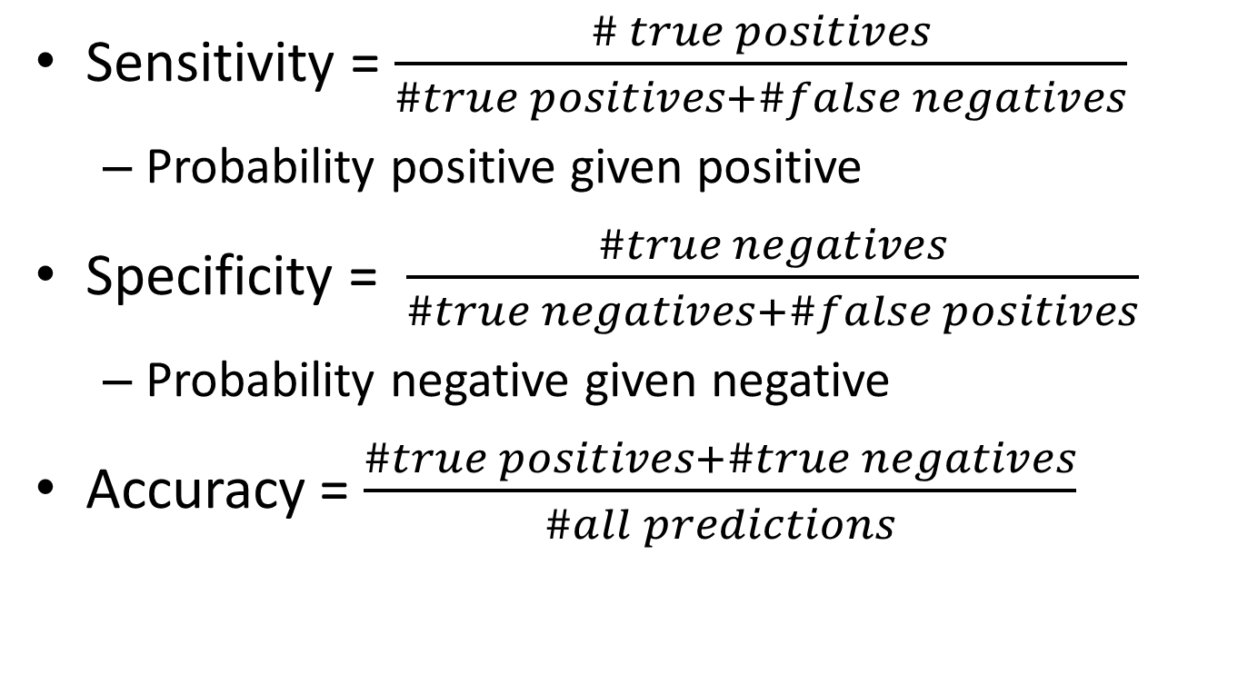
Performance
Sensitivity = $\frac{\# true positives}{\#true positives+\#false negatives}$
Probability positive given positive
Specificity = $\frac{\#true negatives}{\#true negatives+\#false positives}$
Probability negative given negative
Accuracy = $\frac{\#true positives+\#true negatives}{\#all predictions}$

Slide 25
ROC Curve
Graphical way to show the trade-off between sensitivity and specificity
To pick the best threshold
Simultaneously displays both types of errors for all possible thresholds
Plot the
True Positive rate (i.e. sensitivity) against
the False Positive Rate (i.e. 1 – specificity)

Slide 26
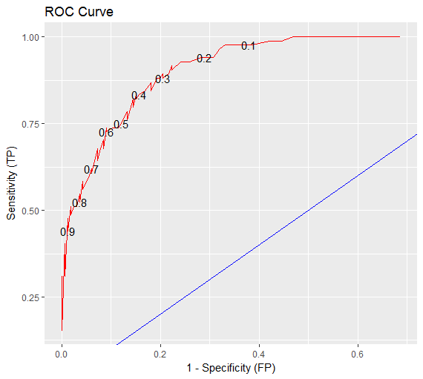
ROC Curve
Decision rules

Slide 27
ROC Curve
The Area Under the Curve (AUC) summarizes the overall performance
percentage of time model will classify correctly
Want AUC to be close to 1
AUC of 0.5 indicates “no better than chance”
The best decision rule is high on sensitivity and low on 1-specificity
predicts most true positives will be a positive and few true negatives will be a positive

Slide 28
R – glm() example continued
# When last we left off
model1=glm(y~X1+X2+X3, data=train, family=binomial)
prediction1 =predict(model1, newdata=test, type="response")
t1 = table(train$Y, prediction1 >= 0.50) #decision rule
t1 # confusion matrix
sensitivity <- t1[4]/(t1[2] + t1[4])
specificity <- t1[1]/(t1[1] + t1[3])
accuracy <- (t1[1] + t1[4])/(t1[1] + t1[2] + t1[3] + t1[4])

Slide 29
Error Measures
The in-sample error, E_{in}
Uses the training data
Measures the training performance
The out-of-sample error, E_{out}
Uses the test data
Measures how well the hypothesized function generalizes to previously unseen data

Slide 30

Errors

Slide 31
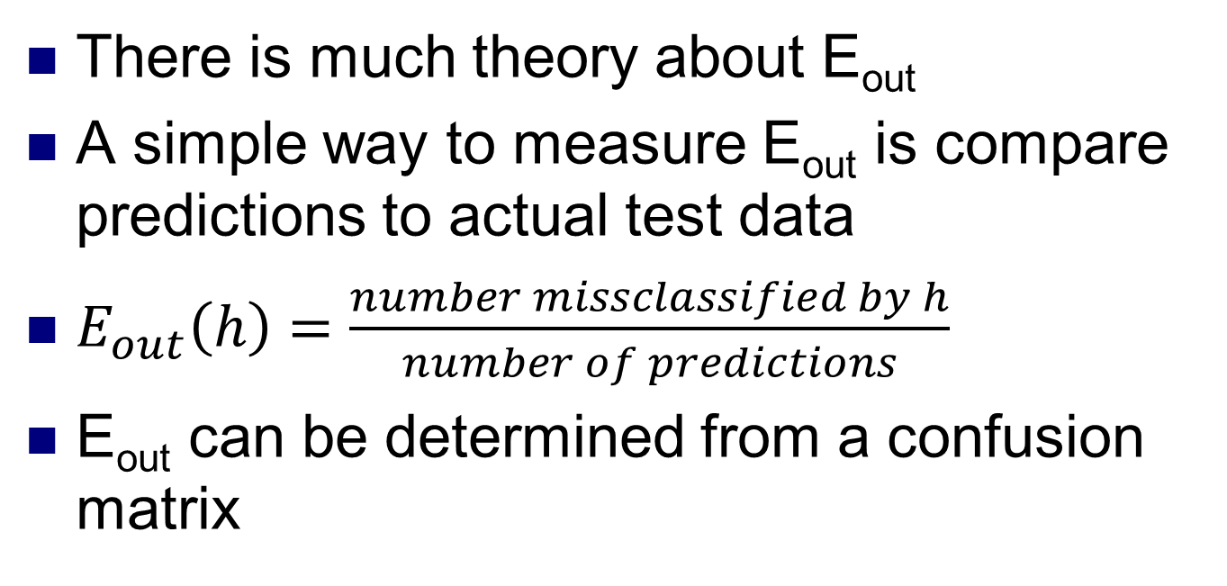
Out-of-sample Error
There is much theory about E_{out}
A simple way to measure E_{out} is compare predictions to actual test data
$E_{out}\left(h\right)=\frac{number missclassified by h}{number of predictions}$
E_{out} can be determined from a confusion matrix

Slide 32
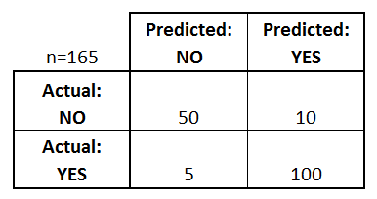
Example – Confusion Matrix
Let us say there are 165 predictions.
50 are predicted “No” and actually “NO”
10 are predicted “Yes” but actually “NO”
5 are predicted “NO” but actually “Yes”
100 are predicted “YES” and actually “Yes”

Slide 33
Example – Confusion Matrix
True Negatives
False Positives
False Negatives
True Positives

Slide 34
Example – Confusion Matrix
Sensitivity = TP/ (TP + FN) = 100 / (100+5)
Specificity = TN / (TN + FP) = 50 / (50 + 10)
Accuracy = (TP + TN) / n = (50+100) / 165
E_{out} = (FP + FN) / n
TN
FP
FN
TP

Slide 35
Readings
Read pp. 194-208 of Bruce and Bruce, Practical Statistics
Read “What Is an ROC Curve” https://www.theanalysisfactor.com/what-is-an-roc-curve/
Read “How To Go About Interpreting Regression Cofficients” https://itsalocke.com/blog/how-to-go-about-interpreting-regression-cofficients/
More Info on Wikipedia https://en.wikipedia.org/wiki/Receiver_operating_characteristic

Slide 36
Questions

Slide 37
Backup Slides

Slide 38
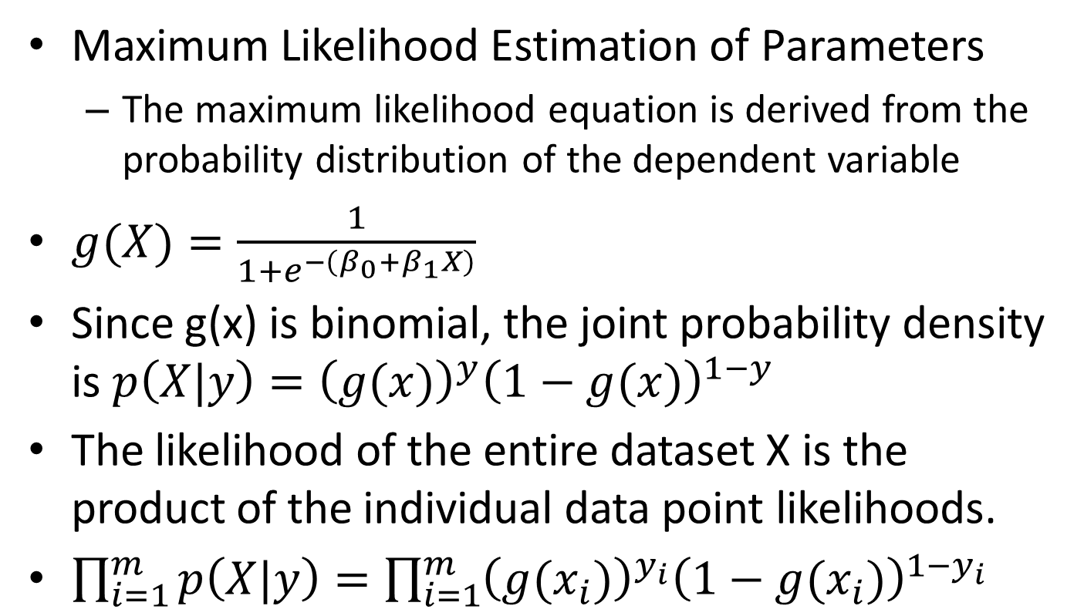
Logistic Function
Maximum Likelihood Estimation of Parameters
The maximum likelihood equation is derived from the probability distribution of the dependent variable
$g(X)=\frac{1}{1+e^{−\left(β_{0}+β_{1}X\right)}}$
Since g(x) is binomial, the joint probability density is $p\left(X|y\right)={\left(g(x)\right)}^{y}{\left(1−g(x)\right)}^{1−y}$
The likelihood of the entire dataset X is the product of the individual data point likelihoods.
$\prod_{i=1}^{m}{p\left(X|y\right)}=\prod_{i=1}^{m}{{\left(g(x_{i})\right)}^{y_{i}}{\left(1−g(x_{i})\right)}^{1−y_{i}} }$

Slide 39
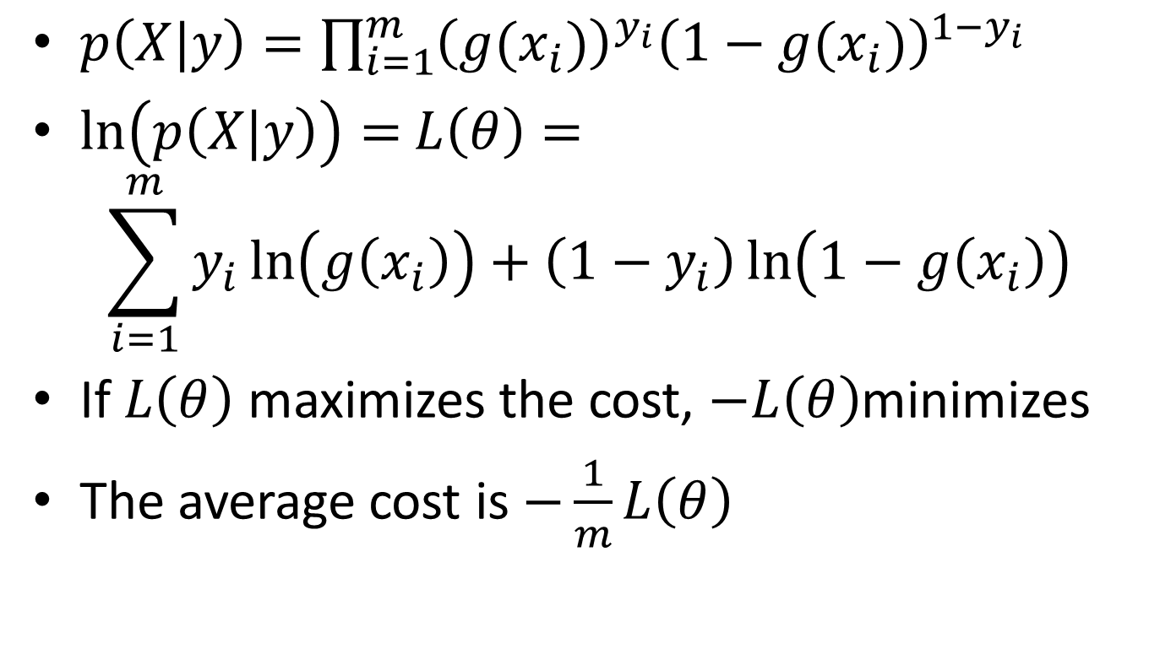
Logistic Function
$p\left(X|y\right)=\prod_{i=1}^{m}{{\left(g(x_{i})\right)}^{y_{i}}{\left(1−g(x_{i})\right)}^{1−y_{i}} }$
$\ln\left(p\left(X|y\right)\right)=$ $L\left(θ\right)=$
$$\sum_{i=1}^{m}{y_{i}\ln\left(g\left(x_{i}\right)\right)+\left(1−y_{i}\right)\ln\left(1−g\left(x_{i}\right)\right)}$$
If $L\left(θ\right)$ maximizes the cost, $−L\left(θ\right)$minimizes
The average cost is $−\frac{1}{m}L\left(θ\right)$

Slide 40
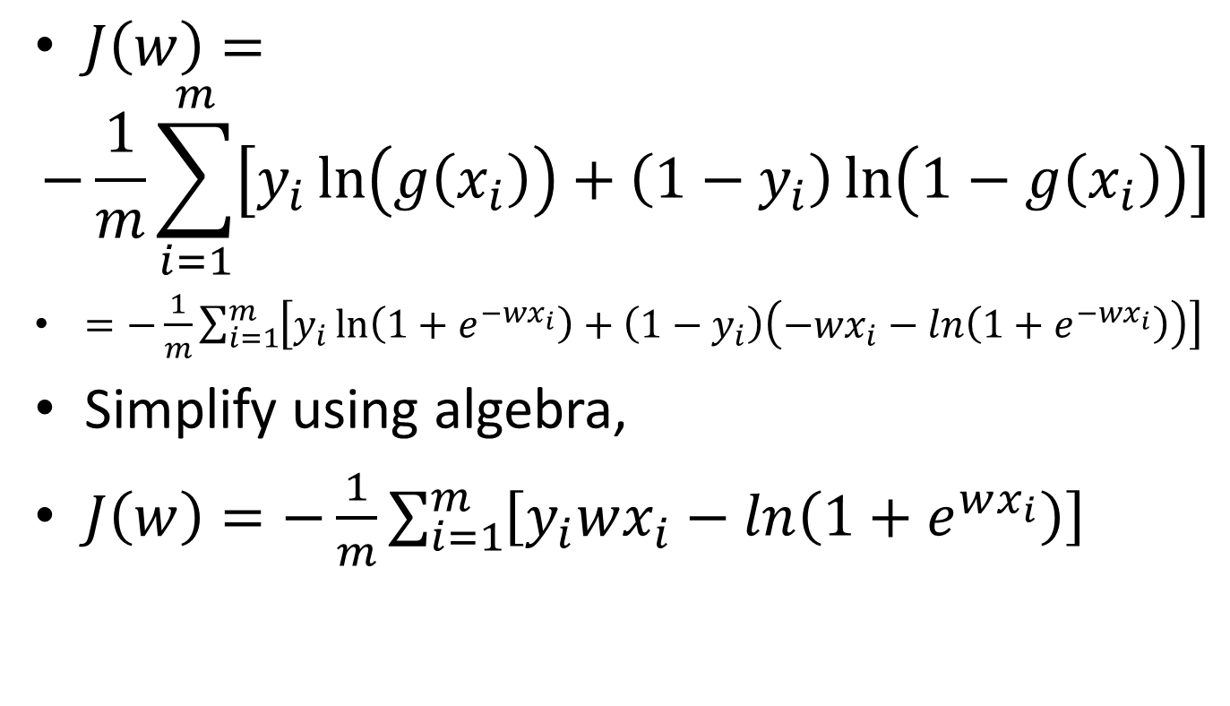
Logistic Function
$J\left(w\right)=$
$$−\frac{1}{m}\sum_{i=1}^{m}{\left[y_{i}\ln\left(g\left(x_{i}\right)\right)+\left(1−y_{i}\right)\ln\left(1−g\left(x_{i}\right)\right)\right]}$$
$=−\frac{1}{m}\sum_{i=1}^{m}{\left[y_{i}\ln\left(1+e^{−wx_{i}}\right)+\left(1−y_{i}\right)\left(−wx_{i}−ln\left(1+e^{−wx_{i}}\right)\right)\right]}$
Simplify using algebra,
$J\left(w\right)=−\frac{1}{m}\sum_{i=1}^{m}{\left[y_{i}wx_{i}−ln\left(1+e^{wx_{i}}\right)\right]}$

Slide 41
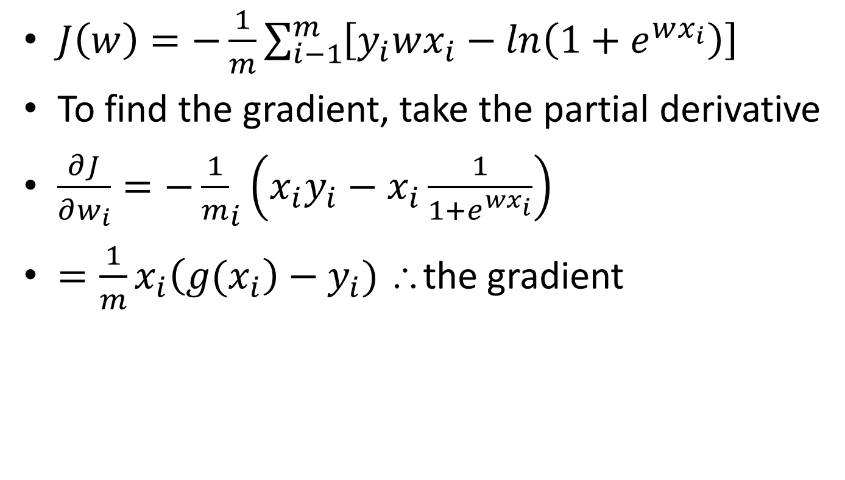
Logistic Function
$J\left(w\right)=−\frac{1}{m}\sum_{i−1}^{m}{\left[y_{i}wx_{i}−ln\left(1+e^{wx_{i}}\right)\right]}$
To find the gradient, take the partial derivative
$\frac{∂J}{∂w_{i}}={−\frac{1}{m}}_{i}\left(x_{i}y_{i}−x_{i}\frac{1}{1+e^{wx_{i}}}\right)$
$=\frac{1}{m}x_{i}\left(g(x_{i}\right)−y_{i})$ ∴the gradient

